Slide 1
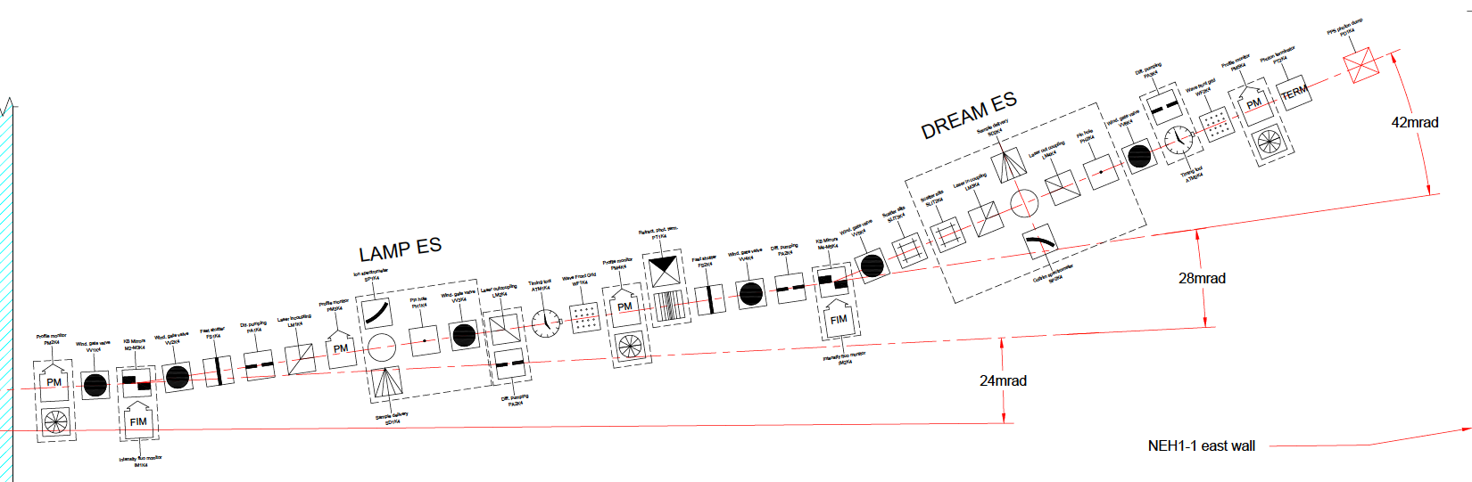
TMO – Hutch 1 ATMs location
Z=768.18
Z=763.133

Slide 2
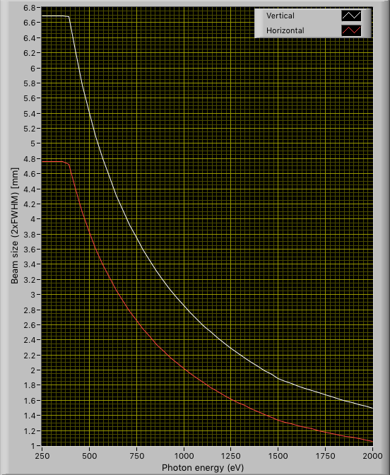

TMO – Spot dimensions (2xFWHM) at Namaste’s ATM
Focusing at 761.743
IP1
Focusing at 761.893
IP1+150 mm

Slide 3
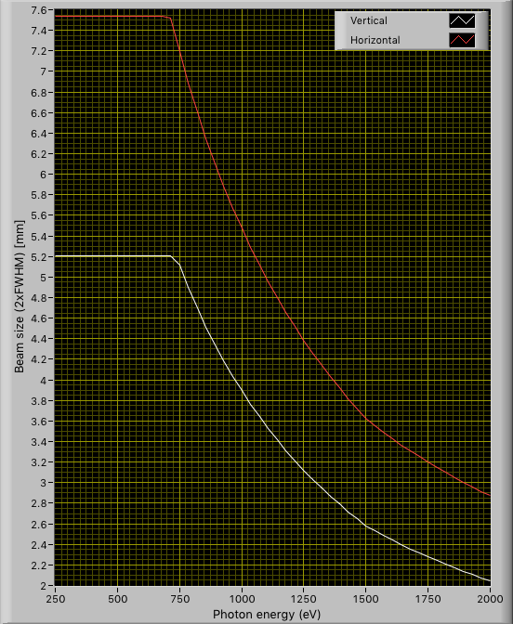
TMO – Spot dimensions (2xFWHM) at DREAM’s ATM
After DREAM

Slide 4
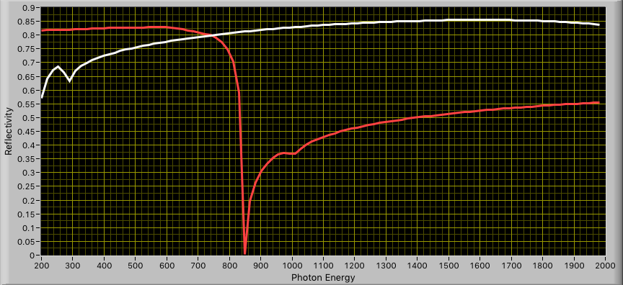
NAMASTE options 1 & 2 [all mirrors]
B4C
5 nm Si on 50 nm Ni
Suggested:
B4C: 12 mm [upper]
5 nm SiO2/Ni: 8 mm [lower]

Slide 5
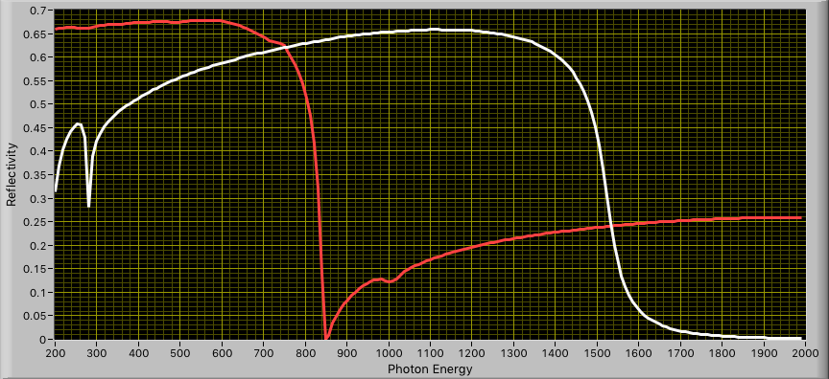
DREAM options 1 & 2 [all mirrors]
B4C
5 nm Si on 50 nm Ni
Suggested:
B4C: 12 mm [upper]
5 nm SiO2/Ni: 8 mm [lower]

